Slide 1
Text Extraction from Image using Fuzzy Logic

Slide 2
Abstract
The recent technological advancements in the field of Image Processing and Natural Language Processing are focusing on developing smart systems to improve the quality of life. In this work, an effective approach is suggested for text extraction from images. The incoming image is firstly enhanced by employing grayscale conversion. Afterwards, the text regions of the enhanced image are detected by employing the Maximally Stable External Regions (MSER) feature detector. The next step is to apply geometric filtering in combination with stroke width transform (SWT) to efficiently collect and filter text regions in an image. The non-text MSERs are removed by using geometric properties and stroke width transform. Subsequently, individual letters/alphabets are grouped to detect text sequences, which are then fragmented into words. Finally, Optical Character Recognition (OCR) is employed to digitize the words. The proposed algorithm is tested on images by using Fuzzy Logic. Promising results have been reported that prove the accuracy and robustness of the proposed framework and encourage its practical implementation in real-world applications.

Slide 3
Agenda
Introduction
Methodology
Implementation
Conclusion
References

Slide 4
Introduction
Today most information is available either on paper or in the form of photographs. Large information is stored in images.
The current technology is restricted to extracting text against clean backgrounds. Thus, there is a need for a system to extract text from general backgrounds.
The role of text detection is to find the image regions containing only text that can be directly highlighted to the user.
Extraction of this useful information involves text detection, localization of text, classification, and then recognition of text.
Fuzzy logic determines the degree of truth values. This logic helps to identify and match the characters accurately.

Slide 5
Existing System
The existing system/previous system of Text recognition on a grid infrastructure is just a text recognition system without grid functionality. That is the existing system deals with the homogeneous character recognition or character recognition of single language.
Drawback:
The drawback in the early text recognition system is that they only have the capability to recognize and convert only the images of English or only of single language. That is the older Text recognition system is Unilingual.

Slide 6
Proposed System
Proposed system is Extraction of text from an image using fuzzy logic, on a grid infrastructure which is a character recognition system that supports recognition of the characters of multiple languages. This feature is what we call grid infrastructure which eliminates the problem of heterogeneous character recognition and supports multiple functionalities to be performed on the image. In this context, Grid infrastructure means the infrastructure that supports group of specific set of languages. Thus, Extraction of text from an image using fuzzy logic on a grid infrastructure is multilingual.

Slide 7
System requirements
Hardware requirements :
Processor : i5 or higher
Ram : 4GB or above
Disk : 250GB
Software requirements :
Technology/Language : Python
Operating system : Microsoft Windows
IDE : Google Colab, Pycharm

Slide 8
Methodology
Modules:
Load image and Gray scale conversion
Detect MSER regions
Noise removal
Stroke width transform
Segmentation
Detected text
Extracted text

Slide 9
Functionalities
Pre-Processing: The image is generally uploaded and scanned by the optical scanner. The image resulting from the scanning process may contain a certain amount of noise.
So, to improve quality of the input image, few operations are performed for enhancement of image such as noise removal, normalization, binarization etc.
Text Recognition: The preprocessing the image to make it suitable for the Convolutional Neural Network (Deep Neural Network).
The module contains algorithms to detect text, segment words and recognise the text i.e., Segmentation, Feature Extraction & Classification
Post-Processing: Next is the final step of recognition system being discussed. It prints the corresponding characters which were recognized in the structured text form which is done by the calculation of equivalent ASCII value using recognition index of the test samples.

Slide 10
Architecture
Architecture diagram is a diagram of a system, in which the principal parts or functions are represented by blocks connected by lines that show the relationships of the blocks
The block diagram is typically used for a higher level, less detailed description aimed more at understanding the overall concepts and less at understanding the details of the implementation.

Slide 11
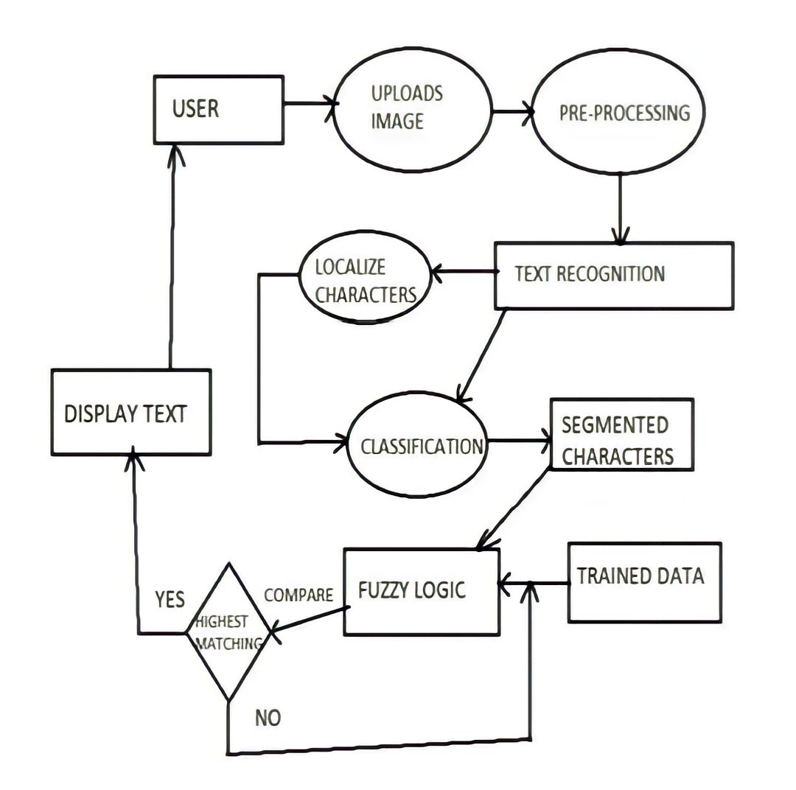

Slide 12
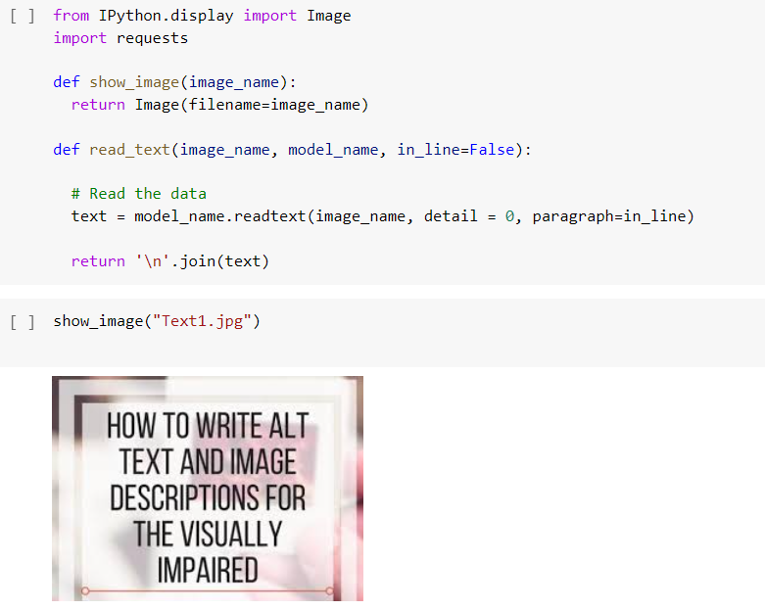
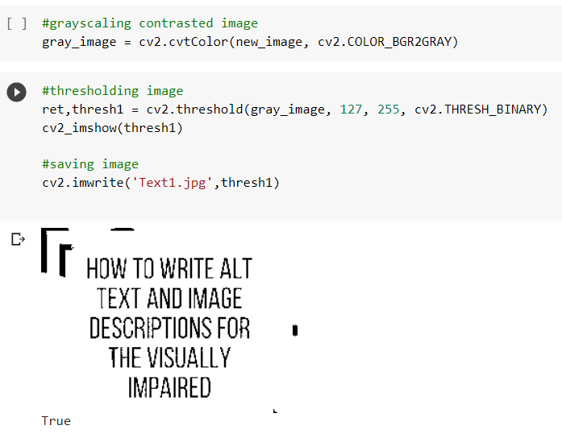
Implementation
Gray scale Conversion:
Loading the image:

Slide 13
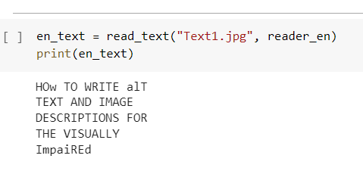
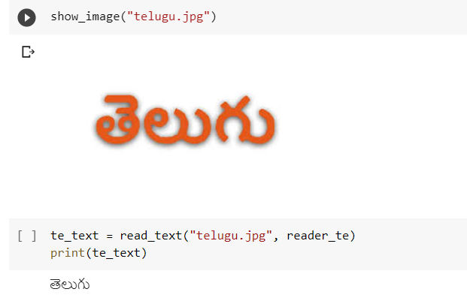
Telugu text extraction :
Text Output:

Slide 14
Conclusion
Nowadays, applications need several kinds of images as sources of information for analysis. When an image is transformed from one form to another such as digitizing, scanning, and communicating, storing, etc. degradation occurs. Therefore, the output image has to undertake a process called image enhancement, which contains a group of methods that seek to develop the visual presence of an image. Fuzzy image processing is a powerful tool form preparation of expert knowledge edge and the combination of inaccurate information from different sources. Extraction of text from an image using fuzzy logic on a grid infrastructure is multilingual. The intended fuzzy rules are an attractive result to improve the quality of edges as much as possible.

Slide 15
References
https://cse.anits.edu.in/projects/projects1920C8.
Gur, Eran, and ZeevZelavsky, “Retrieval of Rashi Semi-Cursive Handwriting via Fuzzy Logic,” IEEE International Conference on Frontiers in Handwriting Recognition (ICFHR), 2012
Gidi Shperber. A gentle introduction to OCR. Oct 22, 2018. URL: https://towardsdatascience.com/a-gentle-introduction-to-ocr-ee1469a201aa. Accessed Dec 19, 2019
D.Trier ,A.K.Jain ,T.Taxt , “Feature Extraction Method for Character Recognition-A Survey” ,Pattern Recognition, 2019
Shejwal, M. A., & Bharkad, S. D. (2017). Segmentation and extraction of text from curved text lines using image processing approach.

Slide 16
Thank you

